Slide 1




Predicting UFC Fight Outcomes with Machine Learning
Team 11:
Amaz Salman 24001042 – Data and Prediction modelling
Forest Bennett 23010240 – Data Acquisition, Engineering and Presentation
Karolina Cardenas 20014550 – Data Acquisition, Front end design and build.
Daniel Soung-Yun Kim 24016358 – Data and Prediction modelling
Who will win: Holloway or Poirier?
This Photo by Unknown Author is licensed under CC BY-NC-ND

Slide 2
Why predict UFC fights?
Can make a person a lot of money if they predict the right winner.
Help sponsors to put their money behind someone who is predicted to win.
Helps fans to learn get deeper understanding of the sport.
Helps train and test prediction models.
The question is: Can we predict the winner of a UFC fight just using fighter statistics?

Slide 3
Data:
Data for fights was acquired using the API from the following site: https://console.sportradar.com/. And for fighters was scraping from http://www.ufcstats.com/statistics/fighters?char={}&page=all
The data included the following for the match data: Match date, competition, final round, final round length, method, scheduled length and weight class.
For the fighters (winner and loser in each match) the following stats was captured: Name, ID, Abbreviation(Names Abbreviation), Gender, qualifier, control, knockdowns, significant strike percentage, significant strikes, significant strikes attempted, submission attempts, takedown percentage, takedowns, takedowns attempted, total strike percentage, total strikes and total strikes attempted.
An additional dataframe was created just for the basic stats of fighters such as: Name, Height, weight, ranking etc. This was created for the frontend.

Slide 4
Feature Engineering:
The data for all the fights was stored in a dataframe.
Duplicate fights were then removed.
Using the following columns for winner and loser, additional columns were created: significant strike percentage, total strike percentage, knockdowns, takedown percentage, takedowns and submission attempts.
Additional columns created: strike_accuracy_diff, total_strike_accuracy_diff, knockdowns_diff, takedown_accuracy_diff, takedowns_diff, submission_attempts_diff.
These additional columns were then utilised to create prediction models.

Slide 5
Modeling Strategy:
Fight stats were used to create prediction models.
The stats used included: strike_accuracy_diff, total_strike_accuracy_diff, knockdowns_diff, takedown_accuracy_diff, takedowns_diff, submission_attempts_diff, weight_class, and method.
These stats were used to create the following models: KNN, Naïve Bayers, Random Forest and Logistic Regression.
All F1 scores for the models were high, with an average of 0.8125.
The highest score was for Random Forest, which scored 0.85.

Slide 6
What we learned:
Random Forest had the highest score of 0.85 on the F1 score.
Features that mattered the most were: Strike Accuracy, takedowns and takedown accuracy and submission attempts.

Slide 7
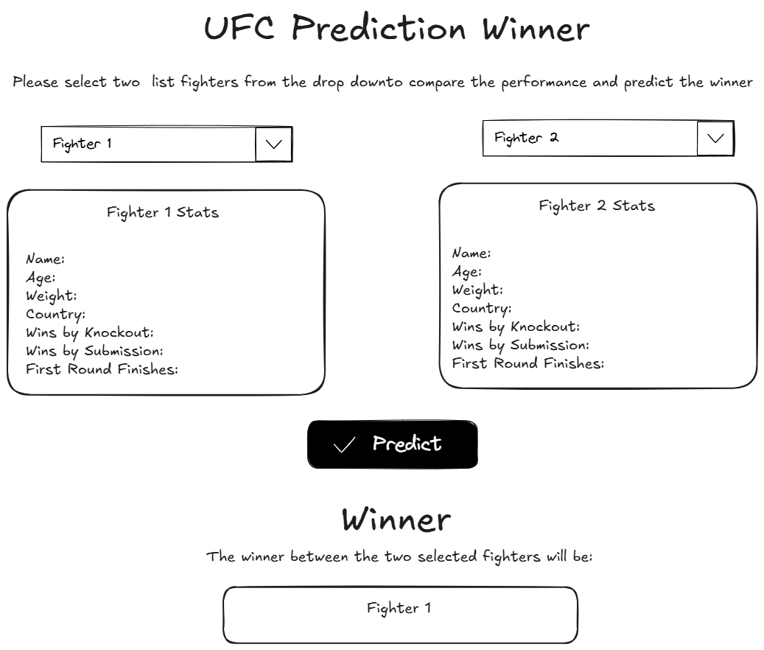
Mockup

Slide 8
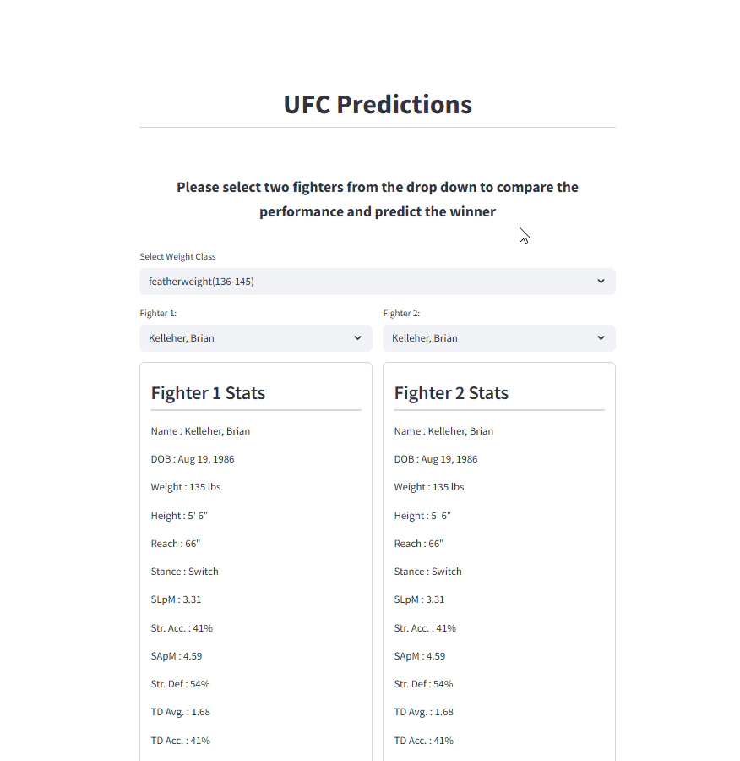
Demo

Slide 9
Conclusion:
Predicting the winner of UFC fights can be accomplished to an extent. With a high score of 0.85 on prediction models Random Forest gives the best predictions. Whilst this is a high score, it would have been more beneficial if the prediction models could be tested in real world scenarios. This can maybe be done in the future. In addition to this, more fighter data may provide better prediction models. This could include the results of the fighters last 5 fights, their age, experience and current rank.

